Slide 1
Google Play Store: App Permission Analytics
Prajit Kumar Das
Advised by: Dr. Anupam Joshi

Slide 2
Data collection stats
According to AppBrain
Current number of Android apps in the market: 1,596,584
54 App categories including Medical and Health & Fitness
46874 Health & Fitness Apps and 23824 Medical Apps
App data collected
Total app data collected: 1,431,736
42958 Health & Fitness Apps and 21033 Medical Apps
Does not reflect app permission info
Total number of apps whose permissions have been collected: 106,979
2620 Health & Fitness Apps and 758 Medical Apps

Slide 3
A bit more stats
Medical Apps request
262 unique permissions, top 20 requested permissions are shown below
Number of apps requesting permission | Permission Name
715 | android.permission.INTERNET
596 | android.permission.ACCESS_NETWORK_STATE
448 | android.permission.READ_EXTERNAL_STORAGE
447 | android.permission.WRITE_EXTERNAL_STORAGE
245 | android.permission.READ_PHONE_STATE
218 | android.permission.WAKE_LOCK
196 | android.permission.VIBRATE
151 | android.permission.GET_ACCOUNTS
145 | android.permission.ACCESS_FINE_LOCATION
143 | android.permission.ACCESS_COARSE_LOCATION
139 | com.google.android.c2dm.permission.RECEIVE
125 | android.permission.ACCESS_WIFI_STATE
91 | com.android.vending.BILLING
85 | android.permission.RECEIVE_BOOT_COMPLETED
80 | android.permission.CAMERA
67 | android.permission.CALL_PHONE
41 | android.permission.READ_CONTACTS
41 | com.google.android.providers.gsf.permission.READ_GSERVICES
41 | com.android.vending.CHECK_LICENSE
34 | android.permission.RECORD_AUDIO

Slide 4
A bit more stats
Health and Fitness Apps request
733 unique permissions, top 20 requested permissions are shown below
Number of apps requesting permission | Permission Name
2501 | android.permission.INTERNET
2204 | android.permission.ACCESS_NETWORK_STATE
1413 | android.permission.WRITE_EXTERNAL_STORAGE
1404 | android.permission.READ_EXTERNAL_STORAGE
816 | android.permission.WAKE_LOCK
715 | android.permission.READ_PHONE_STATE
618 | android.permission.VIBRATE
577 | android.permission.ACCESS_WIFI_STATE
575 | android.permission.ACCESS_FINE_LOCATION
516 | android.permission.ACCESS_COARSE_LOCATION
498 | android.permission.GET_ACCOUNTS
445 | com.google.android.c2dm.permission.RECEIVE
362 | android.permission.RECEIVE_BOOT_COMPLETED
322 | com.android.vending.BILLING
285 | android.permission.CAMERA
173 | android.permission.RECORD_AUDIO
150 | com.android.vending.CHECK_LICENSE
140 | android.permission.GET_TASKS
139 | com.google.android.providers.gsf.permission.READ_GSERVICES
122 | android.permission.SYSTEM_ALERT_WINDOW

Slide 5
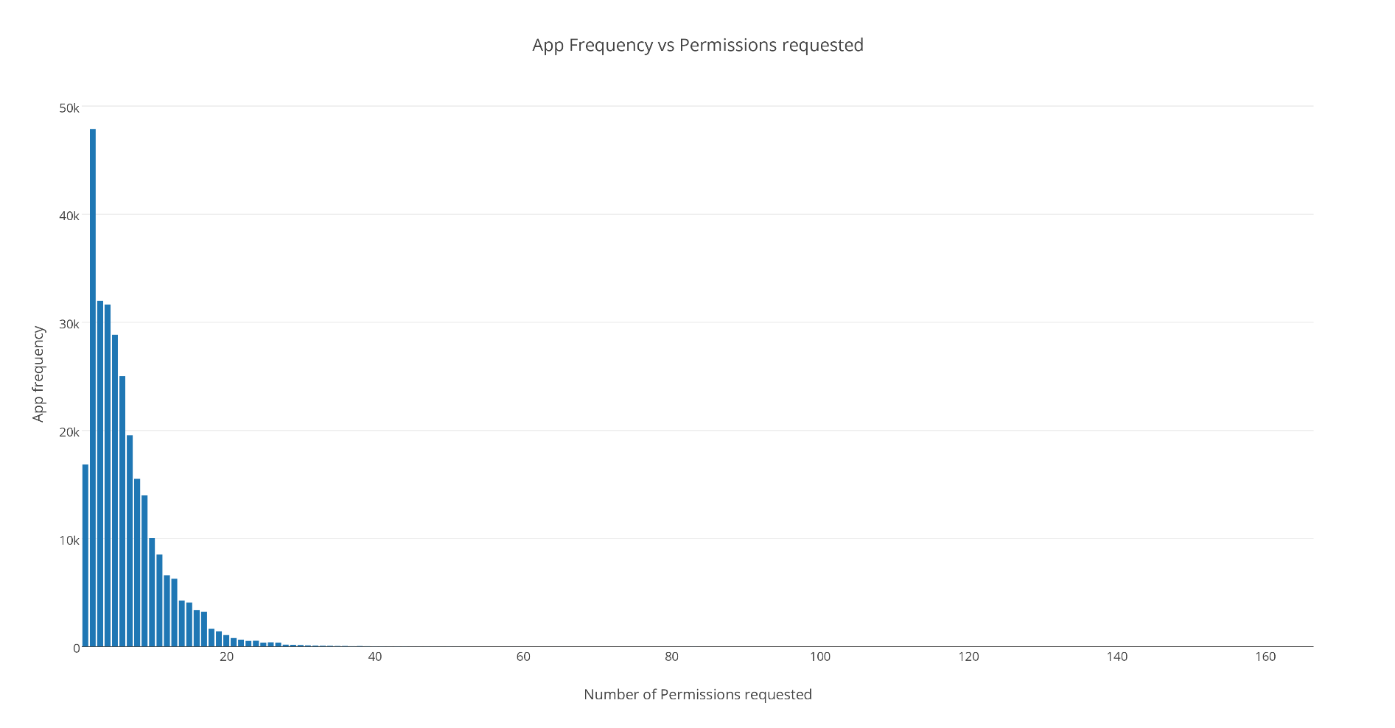
App frequency vs Permissions requested
App Package Name | Permissions Count
com.google.android.gms | 102
com.grabtaxi.system | 84
com.customermobile.att.samsung.gs4 | 83
com.tencent.mtt | 82
com.qihoo360.mobilesafe | 81
com.comfinix.android.barotalk | 81
com.nineninetaxis.driver | 77
com.google.android.googlequicksearchbox | 75
com.airwatch.androidagent | 71
com.qihoo360.launcher | 69
com.vodafone.androidagent | 69
App Count | Permission Name
100863 | android.permission.INTERNET
90819 | android.permission.ACCESS_NETWORK_STATE
64766 | android.permission.READ_EXTERNAL_STORAGE
64703 | android.permission.WRITE_EXTERNAL_STORAGE
39355 | android.permission.READ_PHONE_STATE
34173 | android.permission.ACCESS_WIFI_STATE
33256 | android.permission.WAKE_LOCK
24500 | android.permission.VIBRATE
17503 | android.permission.ACCESS_COARSE_LOCATION
17030 | android.permission.ACCESS_FINE_LOCATION
17003 | android.permission.GET_ACCOUNTS

Slide 6
Algorithm working on
Transform an app to a vector rep by denoting which permission it is requesting
Technique 1: Use vector as an input to k-means clustering – Does app category become evident?
Technique 2: Select a category and using app permission vector try to detect outlier apps
Technique 3:
For apps requesting a bunch of unique permissions, extract app description
Can semantic similarity help in matching descriptions to permissions

Slide 7
Cluster evaluation
K-Means cluster evaluation measures:
Homogeneity Score: A clustering result satisfies homogeneity if all of its clusters contain only data points which are members of a single class.
Completeness Score: A clustering result satisfies completeness if all the data points that are members of a given class are elements of the same cluster.
Working on other measures and K-Medoid

Slide 8
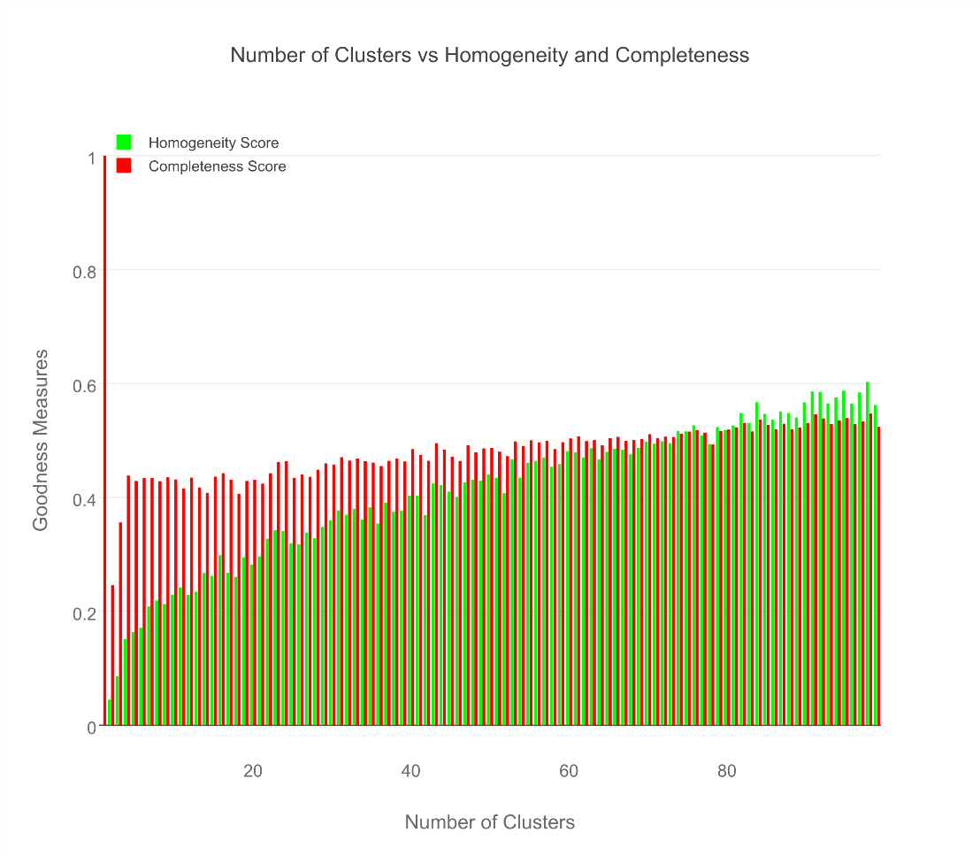
Cluster evaluation

Slide 9
Results for Medical & Healthcare Apps
AppPkgName | Cluster Assignment | AppCategory
com.fitnow.loseit | 13 | Health & Fitness
com.webmd.android | 13 | Health & Fitness
com.drugscom.app | 13 | Medical
com.ovuline.pregnancy | 13 | Medical
air.com.peppapig.paintbox | 13 | Educational
com.t11.skyviewfree | 13 | Education
gov.nasa | 13 | Education
com.google.android.stardroid | 13 | Books & Reference
com.turner.cnvideoapp | 13 | Media & Video
com.nextradioapp.nextradio | 13 | Music & Audio
com.camerasideas.instashot | 13 | Photography
com.foxsports.videogo | 13 | Sports
com.theopen | 13 | Sports
com.tregware.radar | 13 | Weather

Slide 10
Results for All Medical Apps
AppPkgName | Cluster Assignment | AppCategory
com.drugscom.app | 13 | Medical
com.ovuline.pregnancy | 13 | Medical
com.jardogs.fmhmobile | 14 | Medical
com.goodrx | 49 | Medical
com.microphone.earspy | 65 | Medical
com.hp.pregnancy.lite | 75 | Medical
com.carezone.caredroid.careapp.medications | 80 | Medical
com.smsrobot.period | 94 | Medical
epic.mychart.android | 96 | Medical

Slide 11
Results for All Health & Fitness Apps
AppPkgName | Cluster Assignment | AppCategory
com.fitnow.loseit | 13 | Health & Fitness
com.webmd.android | 13 | Health & Fitness
com.period.tracker.lite | 27 | Health & Fitness
com.popularapp.periodcalendar | 27 | Health & Fitness
com.cvs.launchers.cvs | 32 | Health & Fitness
com.babycenter.pregnancytracker | 54 | Health & Fitness
com.fitbit.FitbitMobile | 60 | Health & Fitness
com.myfitnesspal.android | 87 | Health & Fitness
com.google.android.apps.fitness | 91 | Health & Fitness
com.tayu.tau.pedometer | 94 | Health & Fitness

Slide 12
Library Apps seem like the best
AppPkgName | Cluster Assignment | AppCategory
com.aviary.android.feather.plugins.borders.free | 5 | Libraries & Demo
com.aviary.android.feather.plugins.filters.original | 5 | Libraries & Demo
com.aviary.android.feather.plugins.stickers.free_stickers | 5 | Libraries & Demo
com.estrongs.chromecast | 5 | Libraries & Demo
com.foxfi.addon | 5 | Libraries & Demo
com.mxtech.ffmpeg.v7_neon | 5 | Libraries & Demo
com.mxtech.ffmpeg.v7_vfpv3d16 | 5 | Libraries & Demo
com.google.samples.apps.cardboarddemo | 27 | Libraries & Demo
com.google.vr.cardboard.apps.designlab | 27 | Libraries & Demo
com.ivona.tts | 65 | Libraries & Demo

Slide 13
Finance apps seem to pretty uniform
AppPkgName | Cluster Assignment | AppCategory
com.google.android.apps.walletnfcrel | 31 | Finance
com.infonow.bofa | 31 | Finance
com.paypal.android.p2pmobile | 31 | Finance
com.geico.mobile | 32 | Finance
com.creditkarma.mobile | 57 | Finance
com.acorns.android | 58 | Finance
com.chase.sig.android | 58 | Finance
com.venmo | 58 | Finance
com.wf.wellsfargomobile | 58 | Finance

